Slide 1

Retrieval Augmented
Generation (RAG)
Week 4
Tue 13 Aug

Slide 2
What is RAG ?
Definition
The acronym RAG stands for Retrieval Augmented Generation !
Retrieval: Retrieve relevant information or data from a specific source (pdf, API, database etc.) It involves searching and selecting the most appropriate information to be used in generating a response or output.
Augmented: Augment the query with the retrieved information to enhance and generate more accurate and relevant outputs.
Generation: Produce responses based augmented input or context provided. The language model generates new text that is coherent and relevant to the given input or query.
It is a cheaper, easier alternative to fine-tuning LLM with additional specific knowledge by utilizing some advance prompt techniques !

Slide 3
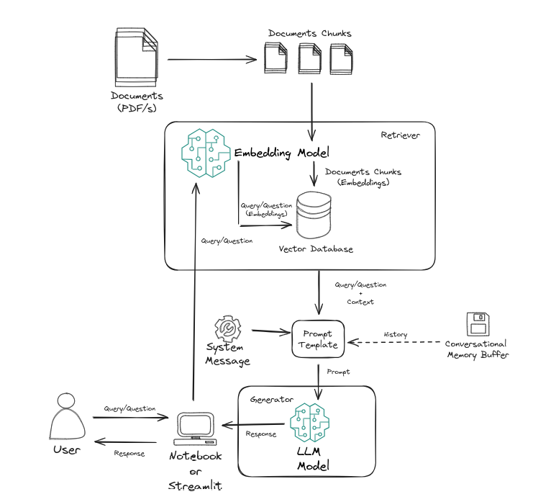
What is RAG ?
Machine Learning Architecture

Slide 4
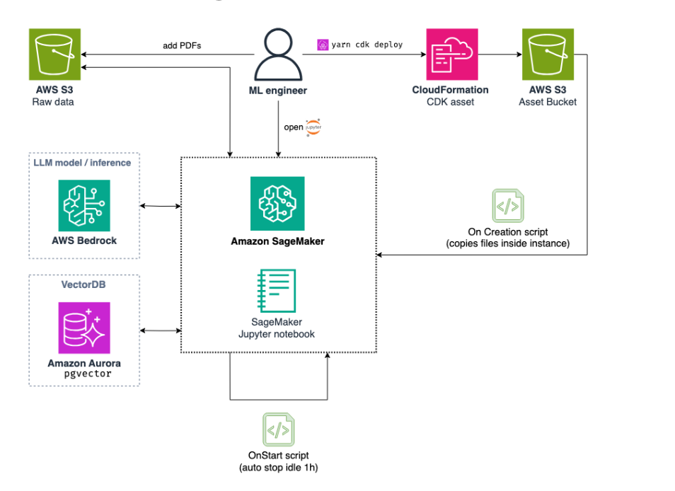
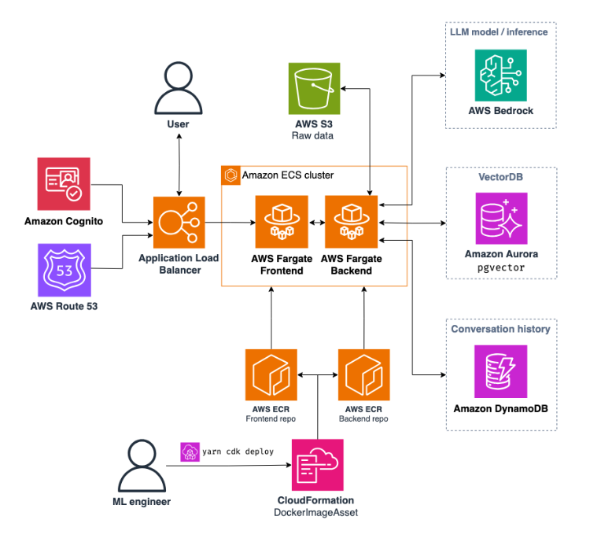
What is RAG ?
Cloud Architecture

Slide 5
What is RAG ?
Orchestration Tools & Platforms
There overall 3 platforms/tools/services that allow easy implementation of RAG:
LangChain - Framework designed to simplify the creation of applications using large language models.
LlamaIndex - Powerful and flexible tool specifically designed to enhance the capabilities of large language models.
AWS Bedrock - AWS Service that mainly is used as provider of fondation models but has tooling that allows orchestration of whole GenAI systems.

Slide 6
Stages of RAG
Preview of the stages
The RAG is defined around two big stages(pipelines):
Data ingestion
Loading, parsing & cleaning data
Chunking data
Embedding data
Ingesting data into Vector Database
Inference
Retriever
Prompt Template creation (+ additional optional elements) - previous week
Generator
Chain definition & creation

Slide 7
Data Ingestion Pipeline

Slide 8
Data Ingestion Pipeline
Loading, parsing & cleaning
Loading & parsing:
HTML data - UnstructuredHTMLLoader, BSHTMLLoader, etc…
Markdown Data - UnstructuredMarkdownLoader
JSON data - JSONLoader
PDF data - PyPDFLoader, PyMuPDFLoader, etc…
CSV data - CSVLoader
Cleaning (Typical NLP Techniques):
Tokenization - Split the text into individual words or tokens.
Remove noise - Eliminate unwanted symbols, emojis, hashtags, and Unicode characters.
Normalization - Convert the text to lowercase for consistency and spelling
Remove stop words - Discard common or repeated words that do not add meaning, such as “a,” “in,” “of,” and “the.”
Lemmatization or stemming - Reduce words to their base or root form.

Slide 9
Data Ingestion Pipeline
Chunking & Chunkers
Fixed size based chunking - n number of words or n number of characters. It is quick and easy but could lead to context fragmentation (the text chosen doesn’t capture the context). Low computational resources are required.
Sentence based chunking - Chunks whole complete sentences. The sentences could be of different sizes and might be incoherent as separate sentences. Low computational resources are required.
Recursive chunking - Most intelligent and most commonly used chunking methodology which produces chunks in an iterative manner such that the desired chunk size and structure is obtained. This further includes a chunking structure which is flexible and hierarchical. High computational resources.
Structural chunking - This is applicable for files which have tags. i.e. HTML, Latex or markdown files. The chunks could be based on headers and sections and chunks are tagged with appropriate metadata.

Slide 10
Data Ingestion Pipeline
Embeddings - Embedding Models
The task of the Embedding Models is to create embeddings (vectors with contextual meaning) to be stored in Vector Database.
Model Size - Size of the model (in GB). It gives an idea of the computational resources required to run the model. While retrieval performance scales with model size, it is important to note that model size also has a direct impact on latency.
Max Tokens - Number of tokens that can be compressed into a single embedding. You typically don’t want to put more than a single paragraph of text (~100 tokens) into a single embedding. So even models with max tokens of 512 should be more than enough.
Embedding Dimensions - The length of the vector. Smaller embeddings offer faster inference and are more storage-efficient, while more dimensions can capture nuanced details and relationships in the data. Ultimately, we want a good trade-off between capturing the complexity of data and operational efficiency.
Most used Embedding Models:
amazon.titan-embed-text:v1
amazon.titan-embed-text:v2
* MTEB Leaderboard

Slide 11
Data Ingestion Pipeline
Vector Databases
When working with Vector Databases, three stages are always included:
Indexing
Querying - Important for Retrieving (Retriever)
Refinement and optimization - Optional stage

Slide 12
Data Ingestion Pipeline
Vector Databases - Indexing
Indexing stage uses a variety of algorithms to index the vectors — with a key objective of enabling efficient and fast querying. The key idea behind all algorithms is how to represent the data in a compressed format so that it can be quickly traversed to get the output. Algorithms for indexing:
Random Projection (RP): Convert high dimensional vectors into low dimensional vectors using encoding while preserving the similarity. For querying use the same encoding to convert the query to lower dimensional vectors.
Product quantization (PQ): Break the original large vector into smaller segments and assign “code(s)” to each segment using some encoding mechanism. For querying, quantize the query vector using the same “code” mechanism.
Locality-sensitive hashing: Very similar to the PQ algorithm, with a key difference being instead of using “code”, this algorithm uses a Hashing mechanism to assign the segments into various buckets. The query uses the same Hashing mechanism.
Hierarchical Navigable Small World (HNSW): In HNSW algorithm, the vectors are tied to buckets called nodes here but the nodes are also structured in a hierarchical manner so that the traversing can happen quickly.

Slide 13
Data Ingestion Pipeline
Vector Databases
Vector Database | Pros | Cons | AWS Deployment
FAISS | Fast, can utilize GPU, easy local deployment for experiments | Disk Indexing | ECS + S3
ChromaDB | Fast, easy local deployment for experiments | Disk Indexing | ECS + S3
Qdrant | Extremely fast, unique integrated Retrieval approaches | Disk Indexing | ECS + S3 or AWS Marketplace
PG Vector | Easy setup for production | Slow for huge loads | RDS or Aurora
OpenSearch | Fast for huge loads | Complex setup | OpenSearch on AWS
*Vector Database Comparison

Slide 14
Hands - On

Slide 15
Inference Pipeline

Slide 16
Inference Pipeline
Retriever
The retriever is the part of the RAG system very the vector database is queried for some query or input. There are three stages that happen at the retriever:
Embedding the query/input using the Embeddings Model to create embeddings same as the one stored in the database
Query the vector database using the embedded query/input and find the most similar embeddings by utilizing the ANN(Approximated Nearest Neighbor) algorithm and different similarity measurements (distance between embeddings vectors). Some of the measurements are:
cosine similarity
dot product
Manhattan distance
Hamming distance
Euclidean distance
Decoding the embedding to text and send it to the generator as context.
*Embedding Vector Space

Slide 17
Inference Pipeline
Generator
Multiple different points need to be taken into consideration when choosing the right LLM which in fact is the generator in one RAG system:
LLM provider - OpenAI vs AWS Bedrock
Type of data - Unstructured vs Structured…
Type of problem - Generation, Classification, Q&A, code generation, etc…
Specific family of models - Claude, GPT, Mistral, Llama…
Token cost
Speed vs Accuracy - Taking into account the size of the LLM
*LLM Leaderboard

Slide 18
Inference Pipeline
Chains
Chains refer to sequences of calls - whether to an LLM, a tool, or a data preprocessing step.
Chain | When to Use
ConversationalRetrievalChain | This chain can be used to have conversations with a document.
StuffDocumentsChain | This chain takes a list of documents and formats them all into a prompt, then passes that prompt to an LLM.
RetrievalQA | This chain first does a retrieval step to fetch relevant documents, then passes those documents into an LLM to generate a response.
LLMRequestsChain | This chain constructs a URL from user input, gets data at that URL, and then summarizes the response

Slide 19
Advanced RAG
Advanced RAG techniques
RAG technique | Goals
Knowledge Graph Integration (Graph RAG) | Utilizing Graph Databases and Retrieval for the RAG
Multi-modal Retrieval | Extending RAG capabilities to handle diverse data types for richer responses.
Self RAG | Adaptively deciding whether to use retrieved information and how to best utilize it in generating responses.
Corrective RAG | A sophisticated RAG approach that dynamically evaluates and corrects the retrieval process,
Adaptive Retrieval | Dynamically adjusting retrieval strategies based on query types and user contexts.
Agentic RAG | Evolution of traditional RAG, integrating AI agents and tools to enhance the RAG approach.

Slide 20
Hands - On

Slide 22
Q&A

